Slide 1
Voyager Database manager
Kevin Mitchell

Slide 2
New Employee
Amy is hired on at the firm
Her supervisor-to-be requests some new equipment from IT
A laptop
Laptop Case
Charging cable
IT receives this request and registers the new user into the Voyager system
IT then pulls up a list of available equipment from the Voyager
IT completes a record for this equipment assignment
The equipment is changed to an Issued State
After completing the hiring process Amy arrives at the IT office to pick up the new equipment
The Laptop case is handed to her and contains all her items

Slide 3
Employee Leaves Firm
Bob has gotten a new job elsewhere, and notifies IT
On Bob’s last day, he brings all equipment he was issued to IT
IT pulls up bob’s assignment records and changes it to a return state

Slide 4
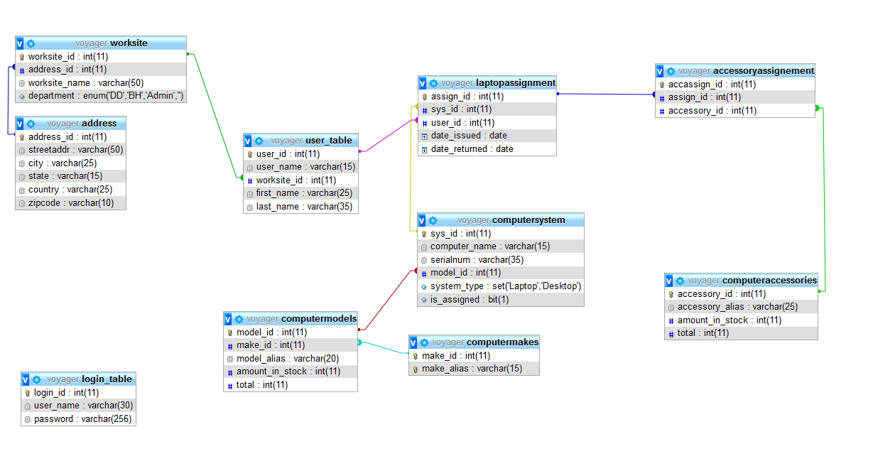
Voyager ER diagram

Slide 5
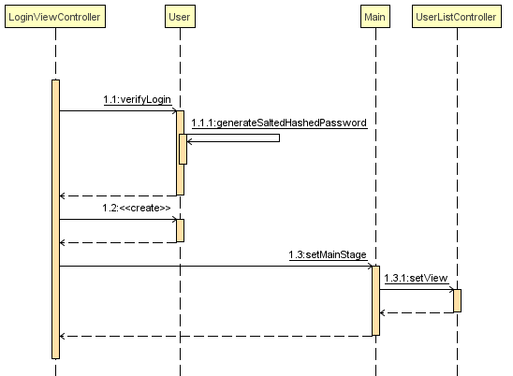
Login Sequence

Slide 6
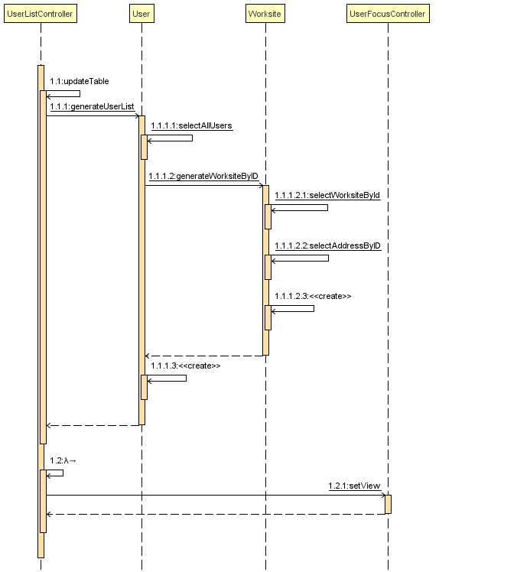
User List Generation

Slide 7
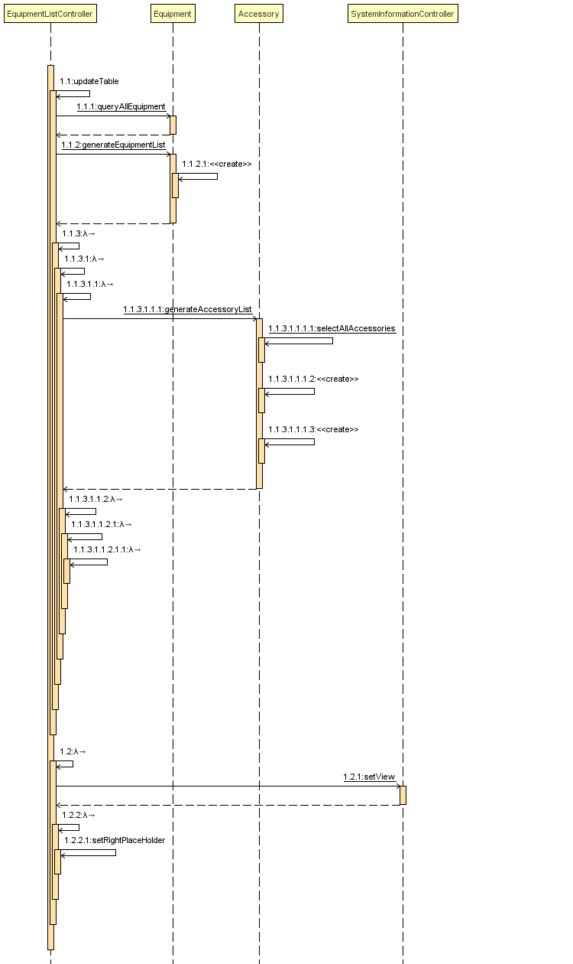
Equipment/Accessory List Generation

Slide 8
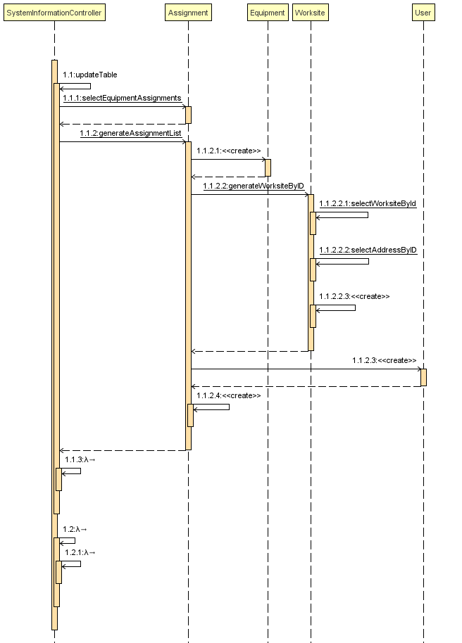
System Information Sequence

Slide 9
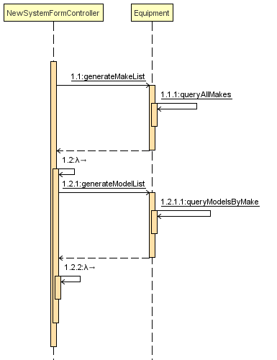
New System Generation

Slide 10
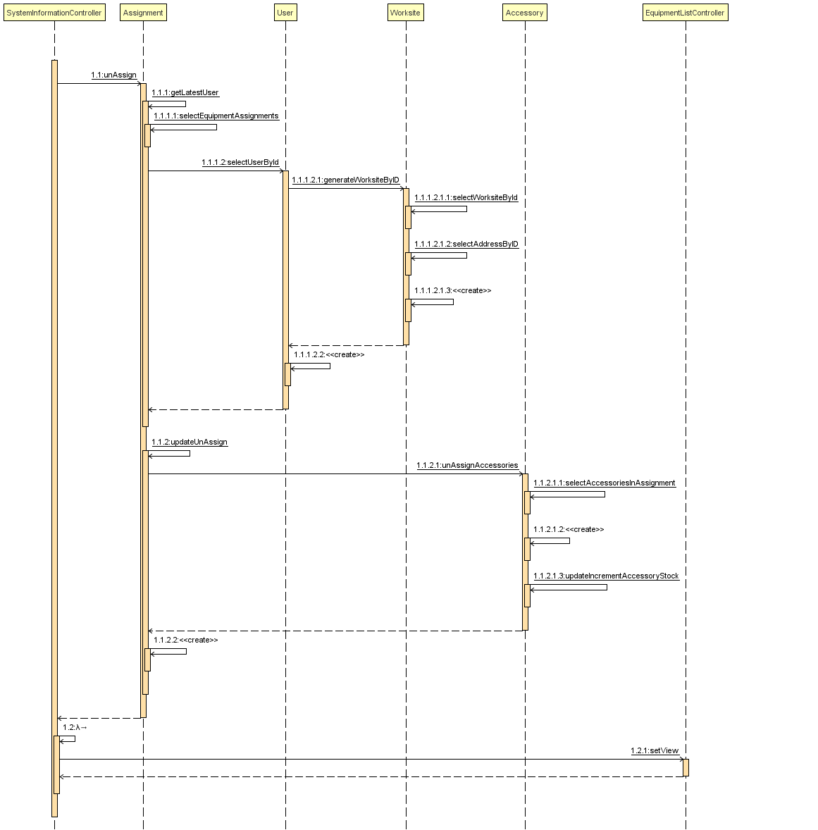
Un-Assignment Sequence

